Slide 1
Epidemiology and Epidemics

Slide 2
What is epidemiology?
study of the distribution and determinants of health problems populations
  applying that information to control health problems
  who diseases affect, what factors are involved, and how can it be contained

Slide 3
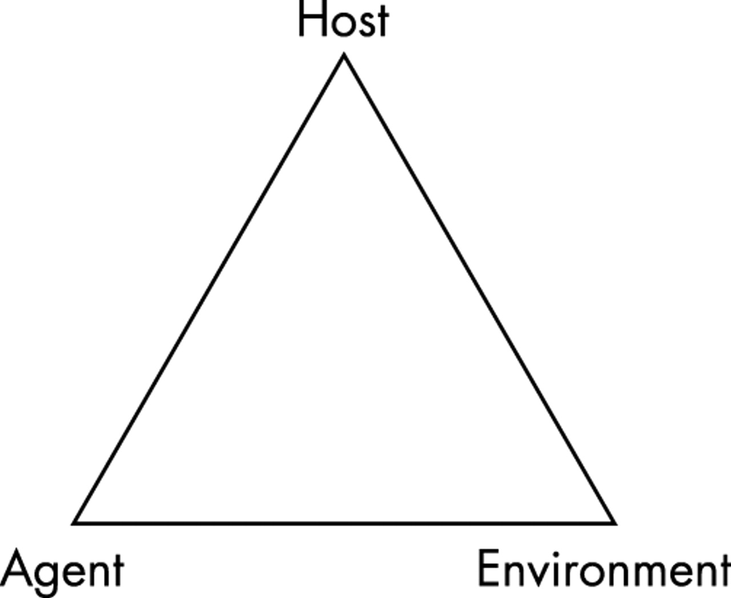
Epidemiologic Triangle
Agent (What)
  microbe that causes the disease
Host (Who)
  organism harboring the disease
Environment (Where)
  external factors which allow or cause disease transmission

Slide 4
Epidemics and Pandemics
epidemic
  more cases of a particular disease than expected in a given area/population
  example:
    Polio 1950s – 58,000+ cases and 3,145 deaths
pandemic
  a widespread epidemic across a large region
  examples:
    Influenza 1918 – infected about 1/3 of the world population, about 100 million deaths worldwide
    HIV/AIDS
    Black Death 1347 – killed about 1/3 of European population

Slide 5
Ebola
hemorrhagic fever
symptoms include:
  fever
  severe headache
  muscle pain/weakness
  fatigue
  vomiting and stomach pain
  unexplained hemorrhage
incubation period is between 2-21 days (avg. 8-10)
recovery depends on care
people who recover develop antibodies that can last for 10 years

Slide 6
Zika
Spreads mostly through mosquitos
Symptoms include:
  Fever
  Rash
  Joint pain
  Red eyes
  Headache
  Muscle pain
Many people don’t get sick enough to go to the doctor…some are asymptomatic
Dangerous if infected during pregnancy
  Linked to microcephaly and other severe brain defects in infants

Slide 7
Nipah
Transmitted through direct contact with pigs, bats, or infected people
Symptoms include:
  Fever
  Headache
  Drowsiness
  Disorientation and confusion
Can progress to a coma within 24-48 hours
Long term effects include persistent convulsions and personality changes
1999 outbreak nearly 300 infected with over 100 deaths
Annual outbreaks in Bangladesh are common

